Slide 1
How can we think together about successful professional education and training?
PD Dr. Stefan Wolf | s.wolf@tu-berlin.de |
Alumni-Seminar: “Initial and Continuing Vocational Education and Training Worldwide (ProETIT)” | 12th Sep. to 16th Sep. 2022 at TU Berlin

Slide 2

Scientific concepts to reach an answer that might help
Outline
Concepts for comparison of different models for Qualifications to Employment (NOT models of TVET)
Cases
  Innovative approaches to modern professional training – Insights from Germany
  TVET in fragile contexts – a new Approach for Somalia
  The intertwining between informal apprenticeship and formal TVET- college training in Nigeria

Slide 3
Systematisation of comparative research in an international perspective
Multi-level analysis from the perspective of a Pedagogy of Gainful Employment
Macro level
Analyses based on perspectives as:
Systems of Qualification to Employment are systems of Social Action
Meso level
Analyses based on perspectives as:
The interaction (functional ones a.o.) of the elements of Qualification to Employment
Micro level
Analyses based on perspectives as:
Learning concepts and their implementation
→ Implications on pedagogical-didactic approaches
Based on The concept of ideal types of the classical vocational training models in Europe (W.-D. Greinert, 2010 etc.)
Notes:
Elements of employment qualification are e.g. school and labour market, educational courses offered and ambitions of families, etc.

Slide 4
To understand properly any solution of
Qualification to Employment in general
Models of Qualification to Employment
Societal perception and beliefs
Education system in the society
Economic needs and requests

Slide 5
Typologies of models of Qualification to Employment
Concept of ideal types of classical European vocational training models from vocational pedagogy in a social and cultural-historical perspective (W.-D. Greinert)
Concept of skill formation systems from political economy in the perspective of the varieties of capitalism approach (e.g. M. Busemeyer and C. Trampusch)
  [Multi-Level Analysis and the 6P strategy of transfer analysis (M. Pilz)]
  [Concept of qualification styles from vocational pedagogy (Th. Deißinger)]
  [Concept of work structuring institutions from sociology (L. Priest)]
  a. o.
Notes:
In order to gain an overview of diversity, as mentioned at the beginning, I need simplifications, i.e. typifications, with the knowledge that social reality remains diverse.

Slide 6
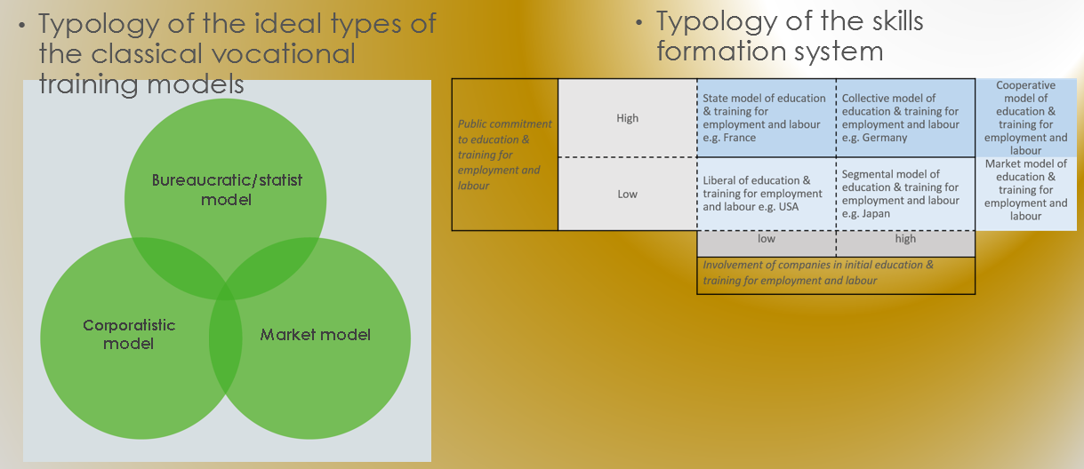
Typologies – useful means to understand the complexity of Qualification to Employment
To understand the ground flow of what means socially a good Qualification model to Employment → with implication on specific moulding at each level (micro to macro)
To understand the relation between government and businesses in initial education and training for employment and labour

Slide 7
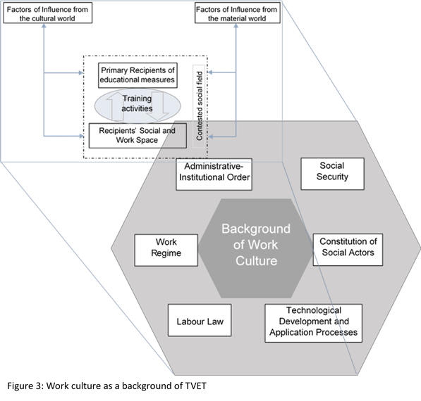
Work cultural background of Qualification to Employment
Employment-related education and training is closely interrelated with other areas of society.
Six dimensions can be identified that shed light on these interrelationships
Successful use as a toolbox to clarify an unfamiliar vocational training situation through dialogue
Analytical explanation of what is meant by the environment in which VET is embedded. (Phillips & Ochs, 2003, 2004)
Notes:
In the upper left corner, the basic understanding of culture is once again indicated and an idea is also given of how the connection between vocational training and culture can be conceptualised.

Slide 8
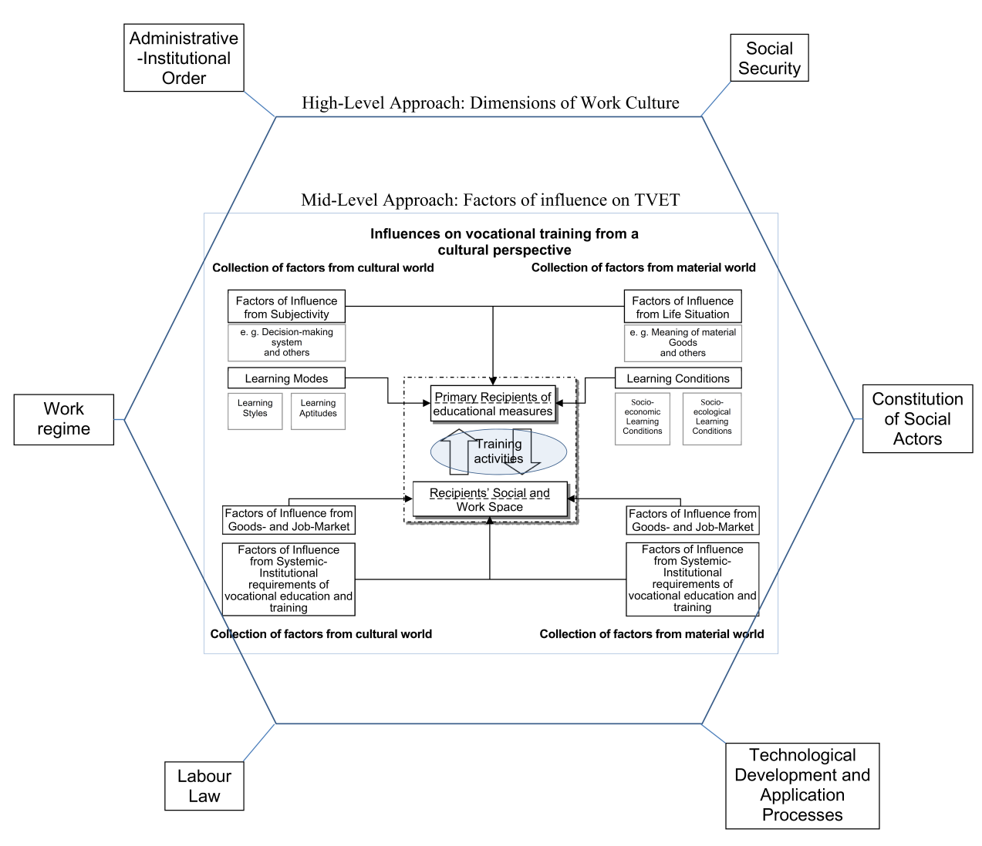
The Transfer Process and the Context we need to understand
for suitable doing it
Concretisation of the "context" through the concept of the "work-cultural background of vocational training" as a heuristic tool for the analysis of "foreign" Qualification to Employment
Clear analysis of the stakeholder groups needed within the innovation measures of qualification for gainful employment to support successful implementation of the pilot measures
Source: Phillips & Ochs, 2004, 779
Notes:
In recent years, we at the TU Berlin have worked on this in two multidisciplinary working groups within the framework of the BMBF's service export programme for the internationalisation of vocational education and training. The first was the transfer of dual training elements to the Egyptian construction industry in the WEB-TT project, and the second was an accompanying study of the transfer of dual training elements to the tourism industry in Greece, the MENDI project.
I will report again a little later on the work-cultural background of vocational training.
We learned to pay special attention to stakeholders in the project in Egypt, where it became very clear in the end that the majority of the company's engineers rejected our sensible approach of training the top level of the workforce, the company's foremen, and that dissemination was difficult during the project period for this reason as well.
Because of the constellation of internal stakeholders, a management consulting approach that has backing from the very top makes sense if you want to implement innovations in education and training.

Slide 9
International & Comparative TVET Research
Presentation of some findings from the scientific field in order to:
Understand better the complexity of real existing Technical and Vocational Education and Training, termed Qualification to Employment to avoid a too narrow understanding of TVET
Facilitate the perceptions of the complexity by the use of typologies
Clarify the process for transfer activities of specific features of qualification from one country to an other one
Get an idea how the context – or the environment in which the qualifications are embedded – would be understood and accordingly analysed

Slide 10
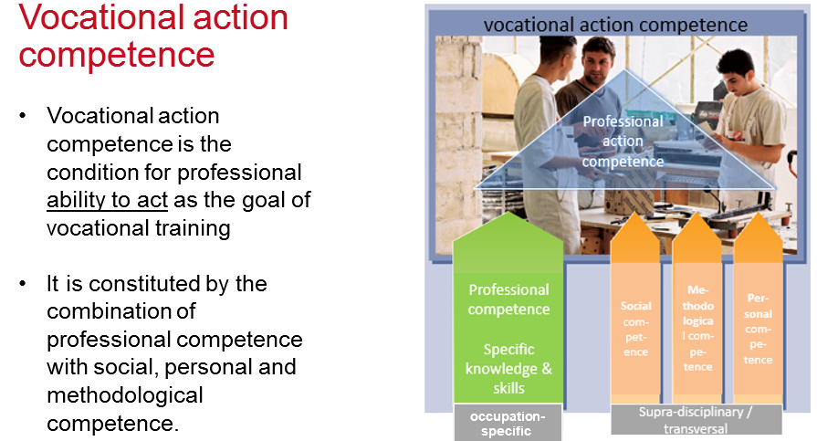
Vocational action competence
Innovative approaches to modern professional training – Insights from Germany
Foundation of the German understanding (→ Bildung): Competence is a inner disposition of the human being, not only means to skill acquisition
It is a main goal of German
Dual VET and
also a requirement of
modern production

Slide 11
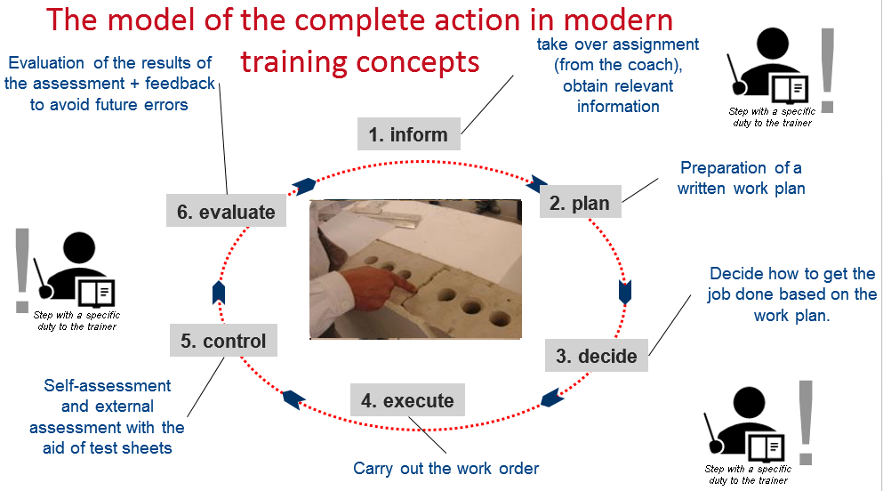
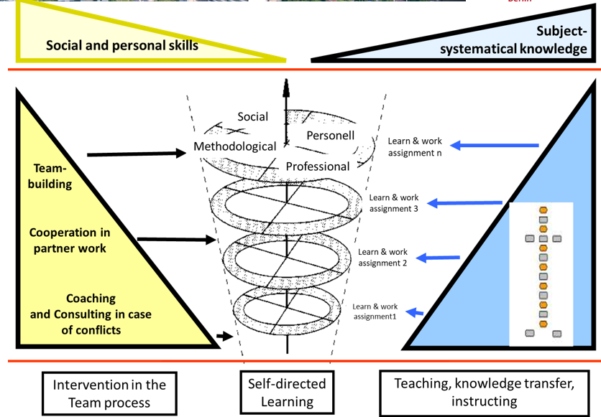
How to implement?
Innovative approaches to modern professional training – Insights from Germany
Complete action method as a core issue
Learn- and Work assignments as a didactical mean to support competence development

Slide 12
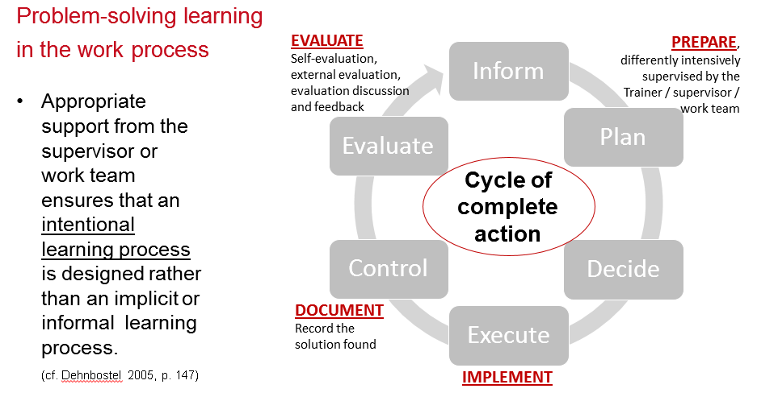
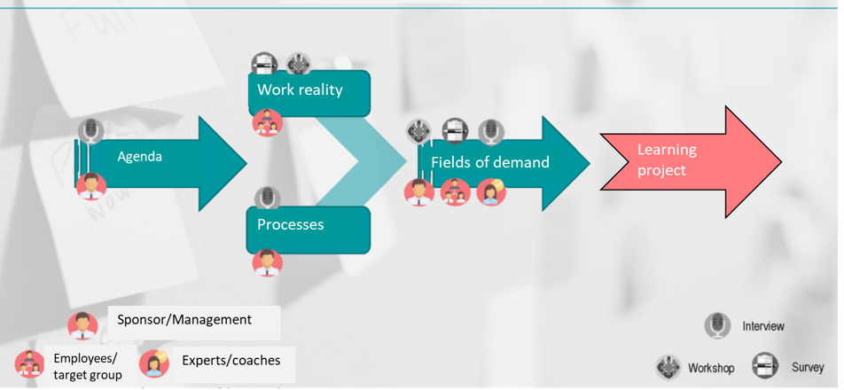
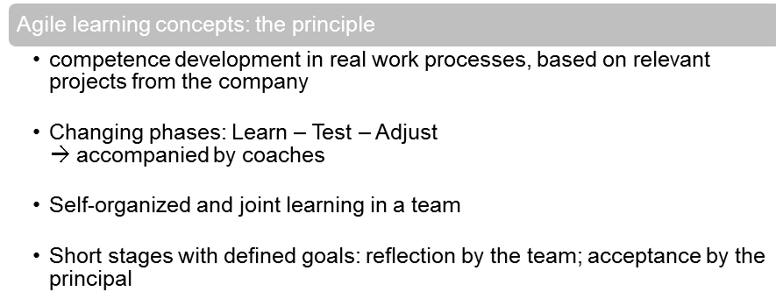
And to continue at the workplace
Innovative approaches to modern professional training – Insights from Germany
By means of problem-solving learning at the workplace – in the work process
Agile learning at the workplace

Slide 13
Our theoretical framework
TVET in fragile contexts – a new approach for Somalia
  The aim of the scientific study was to determine whether vocational education and training can make a contribution to supporting social and economic rehabilitation in fragile, especially dysfunctional, contexts.
  And if so, by what means could this be achieved in a favourable way?
We approached these questions with a qualitative case study approach (Flyvbjerg 2011) and worked within an innovative theoretical framework of three pillars consist of concepts of comparative and international (vocational) education research
  The first pillar is the reception of post-colonial critical research approaches (cf. Watson 1994; Rizvi 2007; Takayama et al. 2016; Tikly & Bond 2013).
  The second pillar is the combination of two approaches, firstly the influential concept of "Policy Borrowing in Education" by D. Phillips et al., the so-called "Oxford models" of comparative educational science and secondly the considerations of "Education in Emergencies (cf. e.g. Rappleye & Paulson 2007).
  The third pillar is a combination of approaches that are all based on the socio-historically and culturally grounded concepts of German comparative VET research (cf. e.g. Greinert 2017) with a specific focus on “Berufsbildung und Gewerbeförderung” Germany’s historical attempt

Slide 14

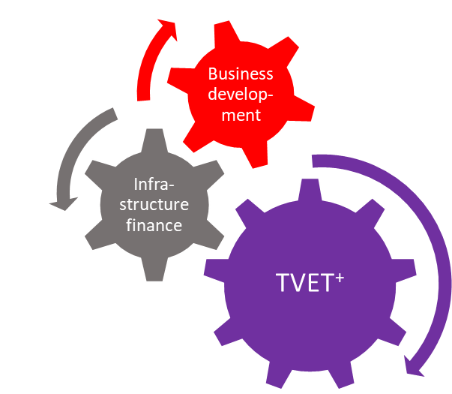
Findings and Recommendations
TVET in fragile contexts – a new approach for Somalia
We bridge the strictly separated silos in development politics of
TVET interventions and economic development approaches with a holistic concept of a three pillars intervention scheme.
Silos of knowledge, practices and politics of TVET development
Silos of knowledge, practices and politics of economic development
Multi-Functional TVET⁺- Hub for inclusive growth and well-being

Slide 15
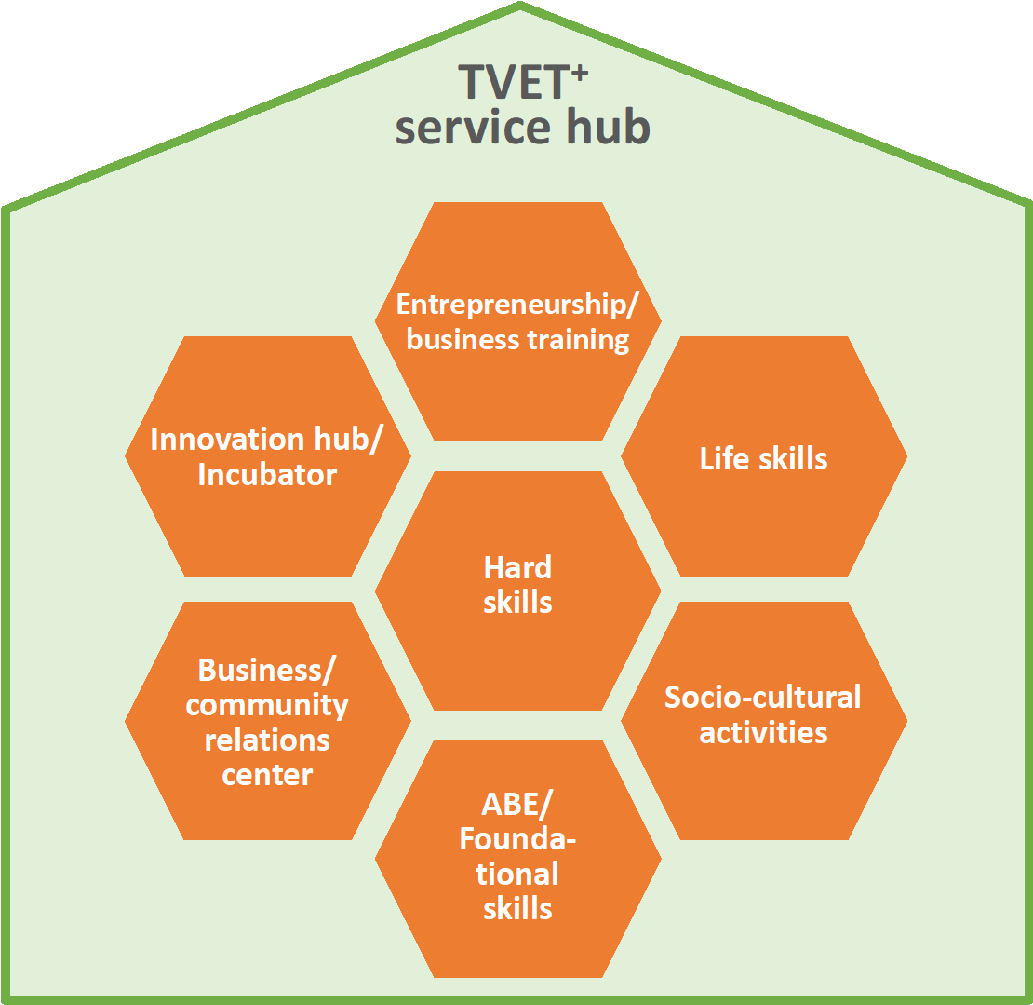
Multifunctional TVET⁺ Service Hub
TVET in fragile contexts – a new approach for Somalia
Three main functions:
  Education and training
  Business development and support
  Community development
  + TVET reputation improvement
Entrepreneurship/ Business Training
Innovation Hub / Incubator
Life Skills
Hard Skills
Business / Community Relations Center
Socio-Cultural Activities
ABE / Founda-tional Skills
Spreading out through a cluster or a social franchising approach

Slide 16
Case of Nigeria: Tensions and interrelations between formal TVET and Qualification in the informal economy
Case of Nigeria: informal qualifications and formal TVET Colleges
Formal TVET in Nigeria
Area of the case study

Slide 17
Informal Qualification to Employment in Nigeria
Case of Nigeria: informal qualifications and formal TVET Colleges
Located in the numerous MSME in the informal economy (2/3 of countries GDP)
A high variety of multifaceted forms of informal qualifications to employment,
Unstructured informal qualification
Structured informal qualification
Unstructured informal apprenticeship
Structured informal apprenticeship
Formalised informal apprenticeship
Traditional apprenticeship
Areas of formal Education and TVET solutions
unstructured
Continuum of unstructured to more formalised Qualification to Employment
formalised
Social relation between “master and apprentice”, Incidental situational instructions and advice
Longer period with stable social relation between “master and apprentice”, with material and personal resources at the work-place
Formal training, Institutional (social and culture) regulated mutual agreements and regulations, based in traditional, often updated communities, embedded social practices
Self-organised informal learning during the work-process
Similar to before but with more socially formalised mutual agreement and regulations, more intentional instructions
informal learning during the work-process supported by on-boarding etc.

Slide 18
Cooperative models of education
Case of Nigeria: informal qualifications and formal TVET Colleges
There is a wide variety of different models of cooperative forms of training
Alternating models (e.g. dual) with public schools and companies
Model with company-owned, public awarded training facilities
School-based education with work-based learning
Industrial attachment program in companies
Sequential internships in companies
Areas of formal Education and TVET solutions
Low
High
Intensity of the relationship of the partners (Educational Institutions and Companies) in cooperative education

Slide 19
Thank you
How can we think together about successful professional education and training?
Questions – Remarks – Notes ?
Professional Education and Training - Scientific Means for Understanding and Inspiring Cases | s.wolf@tu-berlin.de | Alumni-Seminar: 12.09. – 16.09.2022
Seite 19

Slide 20
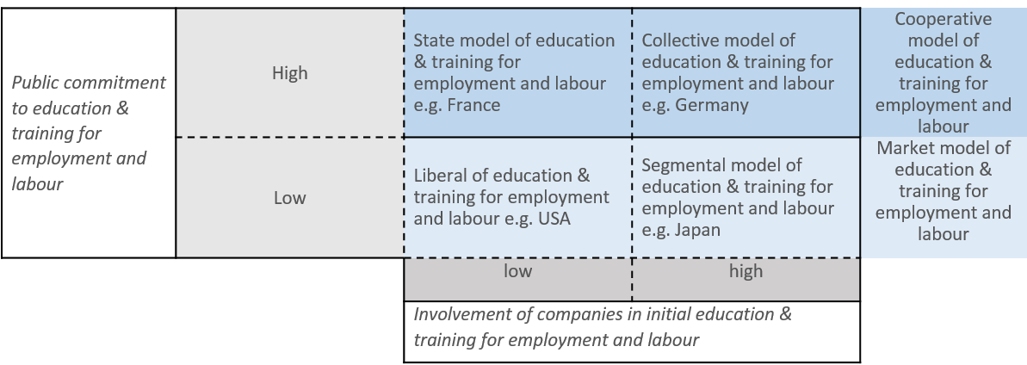
Skills Formation System
Table: The different models of organisation of education & training for employment and labour in developed industrial democracies, see Busemeyer, M. R./Trampusch, C. (2011), p.12

Slide 21

Systematisation of comparative research in an international perspective
Macro-analysis from the perspective of a Pedagogy of Gainful Employment
A system of qualification for gainful employment establishes a context of meaning which has differentiated itself from the plethora of other social contexts of meaning in response to a specific problem — e.g. What is a societal common understanding of a good qualification system?
On this basis, an understanding is possible, since all participants follow certain rules and accept similar patterns of interpretation of their actions.
They represent legitimate regulatory patterns of social action
These regulatory patterns of qualification for gainful employment are embedded in other areas of society, which can be described as the specific work culture of a society.
after: Greinert 1997, p. 17f.
Notes:
Systems of qualification for employment are social systems of action and are characterised by the following features, whereby system is conceived as sociality and is shaped by and with people and social actors

